Slide 1

IT5002
Computer Systems and Applications
Lecture 17
File Systems
colintan@nus.edu.sg

Slide 2
What is a File System?
Present logical (abstract) view of files and directories
Accessing a disk is very complicated:
2D or 3D structure, track/surface/sector, seek, rotation, …
Hide complexity of hardware devices
Facilitate efficient use of storage devices
Optimize access, e.g., to disk
Support sharing
Files persist even when owner/creator is not currently active (unlike main memory)
Key issue: Provide protection (control access)

Slide 3
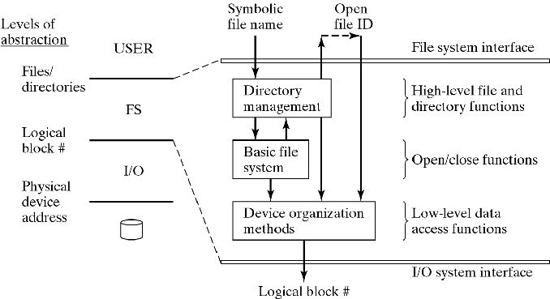
Hierarchical View of File Systems
Directory management:
map logical name to unique Id, file descriptor
Basic file system:
open/close files
Physical device organization:
map file data to disk blocks

Slide 4
User’s View of a File
File name and type
Valid name
Number of characters
Lower vs upper case, illegal characters
Extension
Tied to type of file
Used by applications
File type recorded in header
Cannot be changed (even when extension changes)
Basic types: text, object, load file, directory
Application-specific types, e.g., .doc, .ps, .html

Slide 5
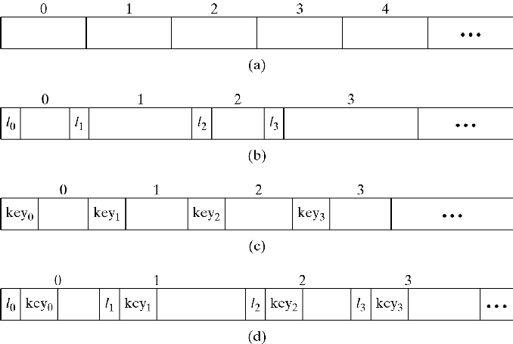
User’s View of a File
Logical file organization
Most common: byte stream
Fixed-size or variable-size records
Addressed
Implicitly (sequential access to next record)
Explicitly by position (record#) or key
a) Fixed Length Record
b) Variable Length Record
c) Fixed Length with Key
d) Variable Length with Key

Slide 6
Operations on Files
Create/Delete
Open/Close
Read/Write (sequential or direct)
Seek/Rewind (sequential)
Copy (physical or just link)
Rename
Change protection
Get properties
Each involves parts of Directory Management, BFS, or Device Organization
GUI is built on top of these functions

Slide 7
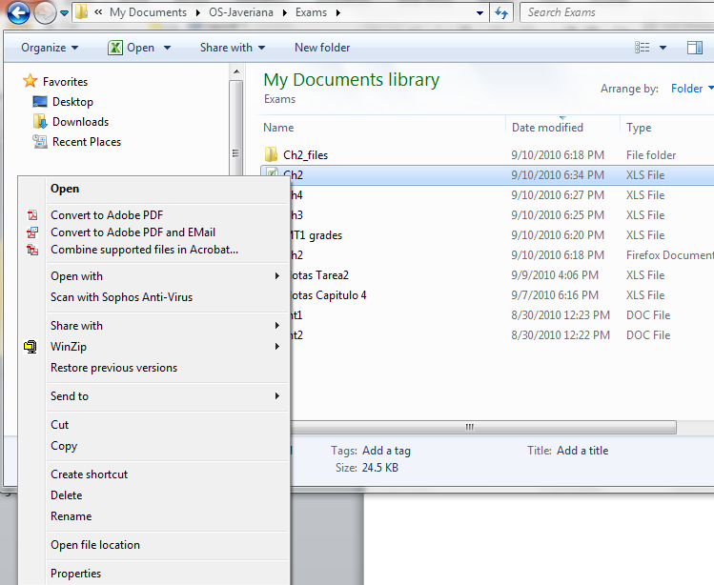
Operations on Files

Slide 8
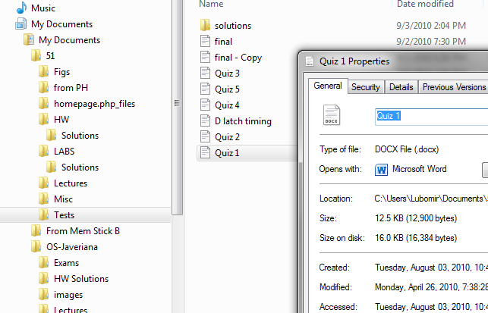
Directory Management
Main issues:
Shape of data structure (e.g. tree, shortcuts, …)
What info to keep about files
Where to keep it? (in directory?)
How to organize entries for efficiency?

Slide 9
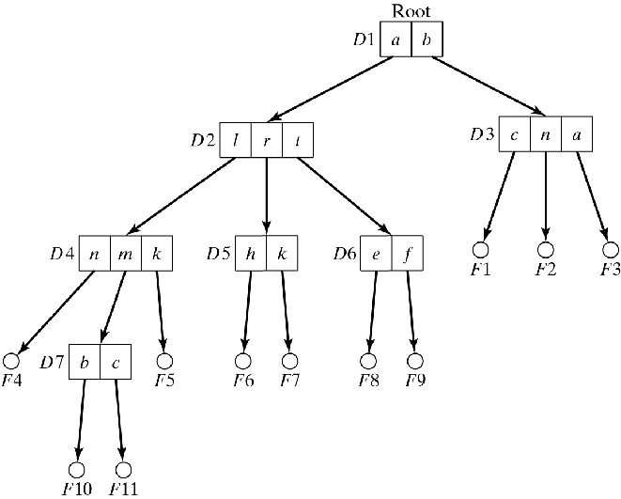
File Directories
Tree-structured
Simple search, insert, delete operations
Sharing is asymmetric (only one parent)

Slide 10
File Directories
How to uniquely name a file in the hierarchy?
Path names
Concatenated local names with delimiter:
( . or / or \ )
Absolute path name: start with root (/)
Relative path name: Start with current directory (.)
Notation to move upward in hierarchy (..)

Slide 11
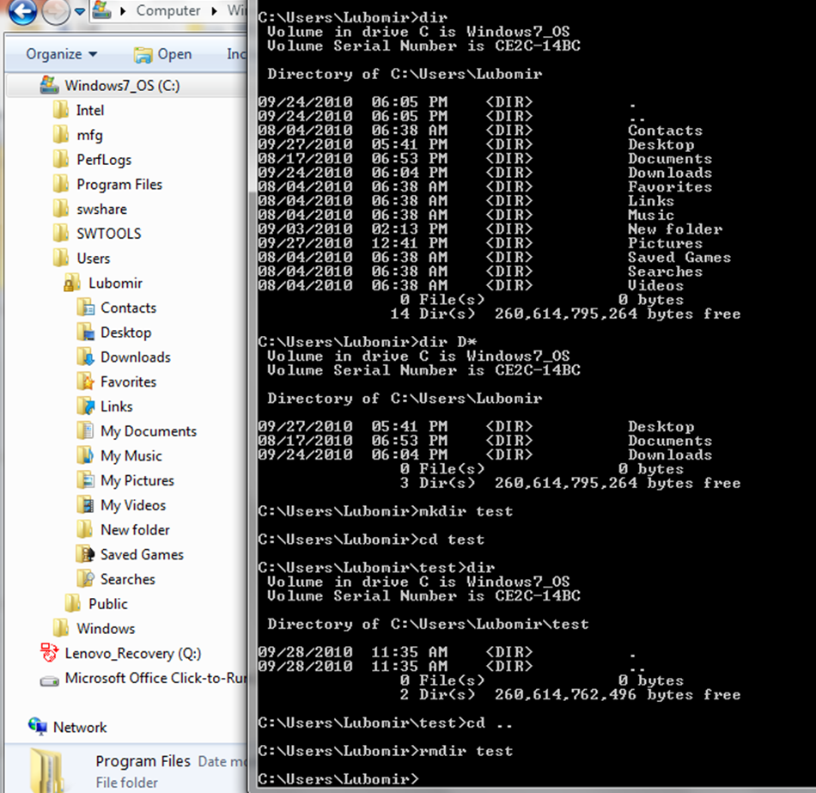
Operations on File Directories
GUI vs commands
Create/delete
List: sorting, wild cards, recursion, information shown
Change (current, working) directory
Move
Rename
Change protection
Create/delete link (symbolic)
Find/search routines

Slide 12
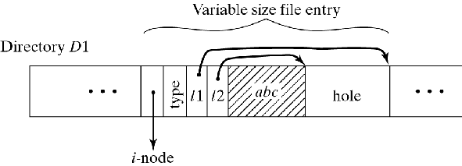
Implementation of Directories
What information to keep in each entry
All descriptive information
Directory can become very large
Searches are difficult/slow
Only symbolic name and pointer to descriptor
Needs an extra disk access to descriptor
Variable name length?

Slide 13
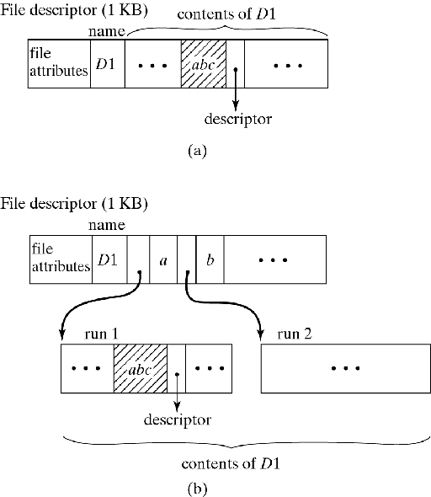
Implementation of Directories
How to organize entries within directory
Fixed-size entries:
use array of slots
Variable-size entries:
use linked list
Size of directory:
fixed or expanding
Example: Windows 2000
when # of entries exceeds directory size, expand using B⁺-trees

Slide 14
Revisit file operations
Assume:
descriptors are in a dedicated area
directory entries have name and pointer only
create
find free descriptor, enter attributes
find free slot in directory, enter name/pointer
rename
search directory, change name
delete
search directory, free entry, descriptor, and data blocks
copy
like create, then find and copy contents of file
change protection
search directory, change entry

Slide 15
Basic File System
Open/Close files
Retrieve and set up information for efficient access:
get file descriptor
manage open file table
File descriptor (i-node in Unix)
Owner id
File type
Protection information
Mapping to physical disk blocks
Time of creation, last use, last modification
Reference counter

Slide 16
Basic File System
Open File Table (OFT) keeps track of currently open files
open command:
Search directory for given file
Verify access rights
Allocate OFT entry
Allocate read/write buffers
Fill in OFT entry
Initialization (e.g., current position)
Information from descriptor (e.g. file length, disk location)
Pointers to allocated buffers
Return OFT index

Slide 17
Basic File System
close command:
Flush modified buffers to disk
Release buffers
Update file descriptor
file length, disk location, usage information
Free OFT entry

Slide 18
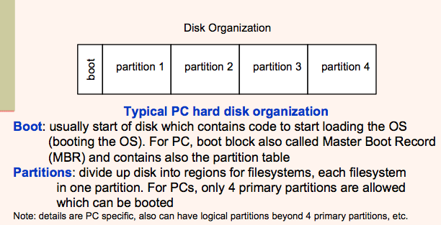
Organizing Data on a Disk

Slide 19
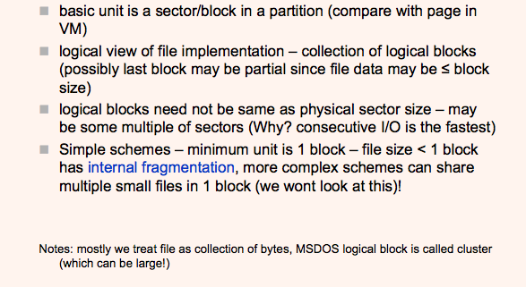
Organizing Files

Slide 20
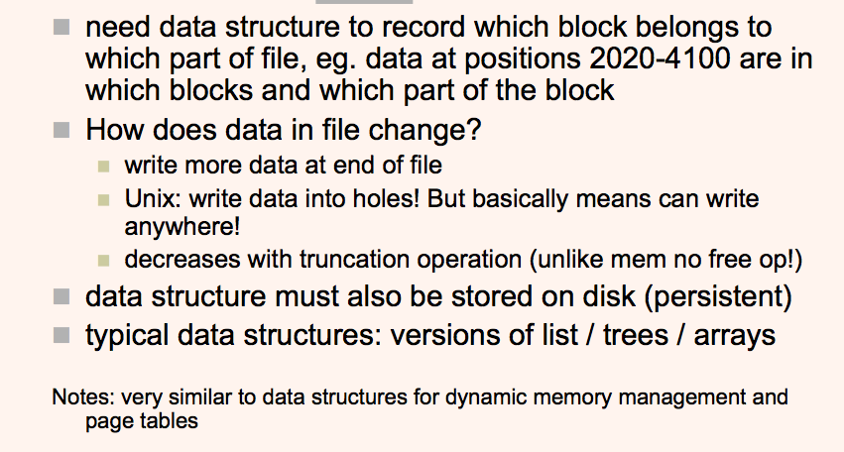
Data Structures on Disk

Slide 21
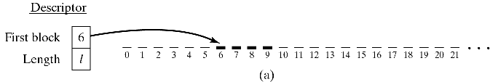
Physical Organization Methods
Contiguous organization
Simple implementation
Fast sequential access (minimal arm movement)
Insert/delete is difficult
How much space to allocate initially
External fragmentation

Slide 22

Physical Organization Methods
Linked Organization
Simple insert/delete, no external fragmentation
Sequential access less efficient (seek latency)
Direct access not possible
Poor reliability (when chain breaks)

Slide 23
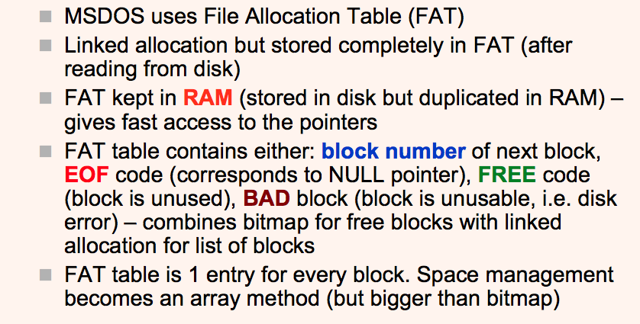
Linked List Allocation - FAT

Slide 24
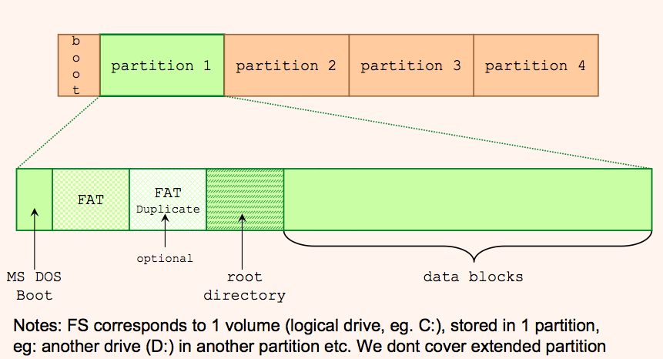
MSDOS File System Layout

Slide 25
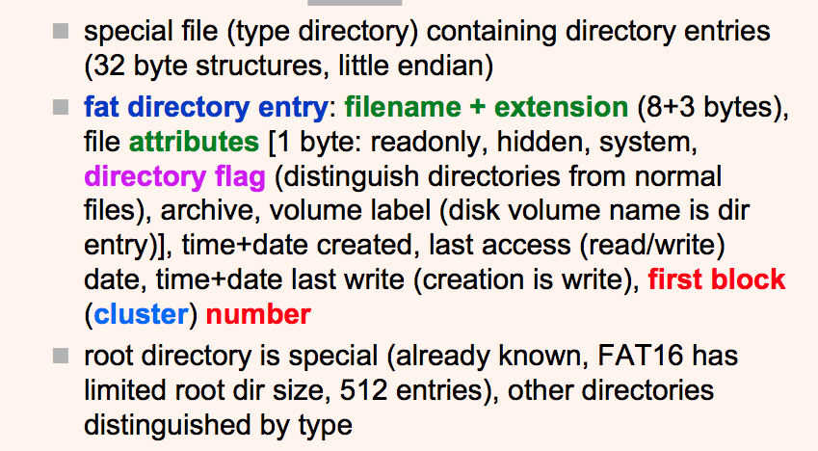
DOS Directory

Slide 26
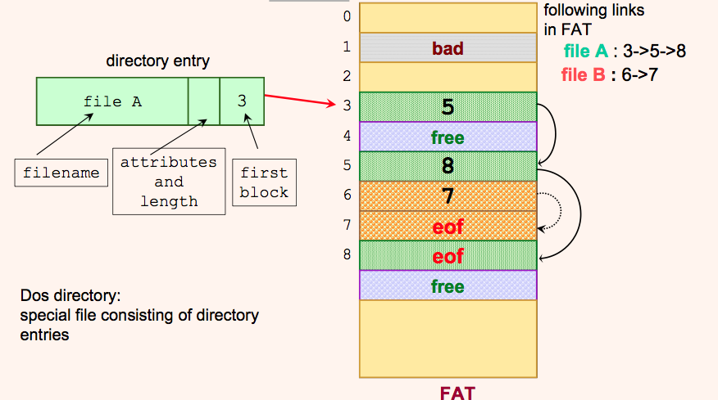
FAT Organization

Slide 27
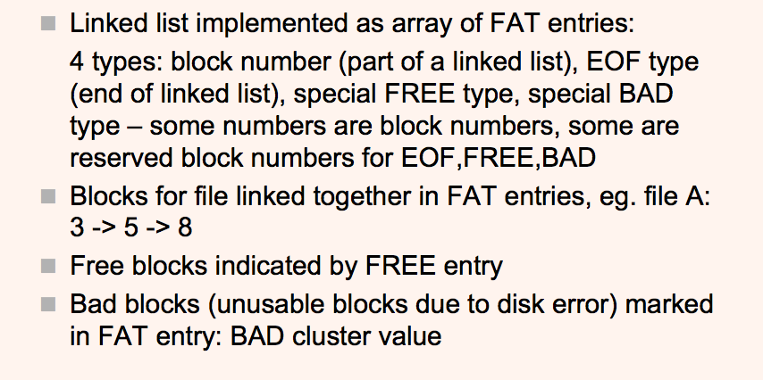
FAT Organization

Slide 28
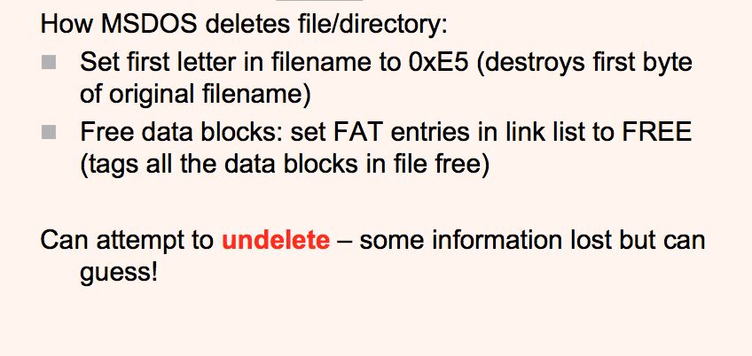
MSDOS: Deleting a File

Slide 29
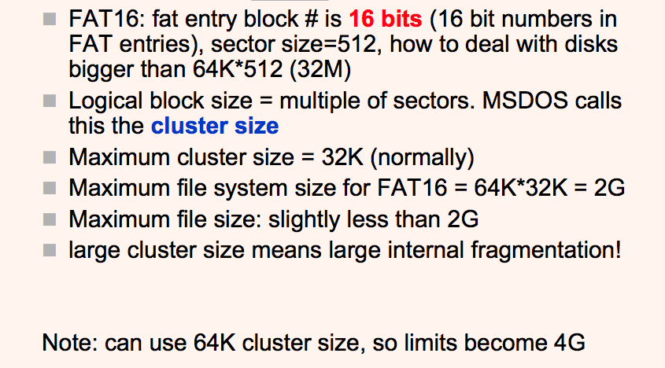
FAT16 Cluster Size

Slide 30
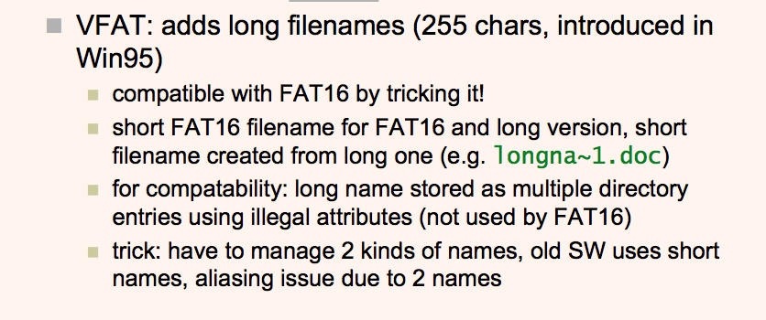
VFAT

Slide 31
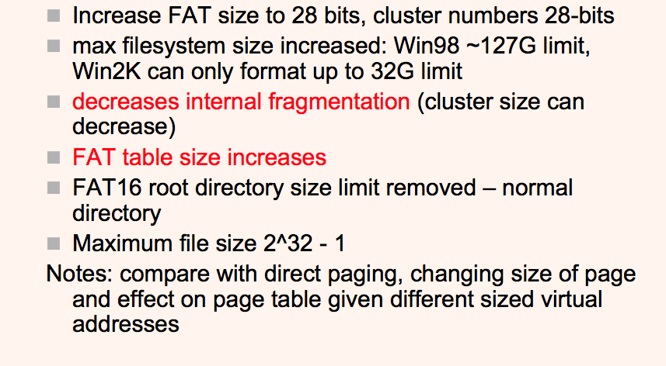
FAT32

Slide 32
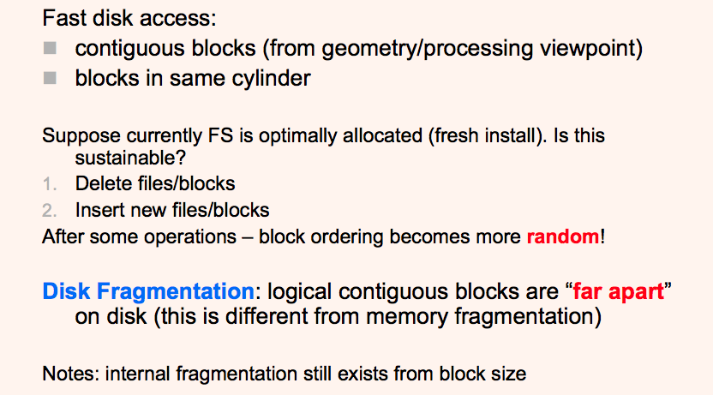
Disk Fragmentation

Slide 33
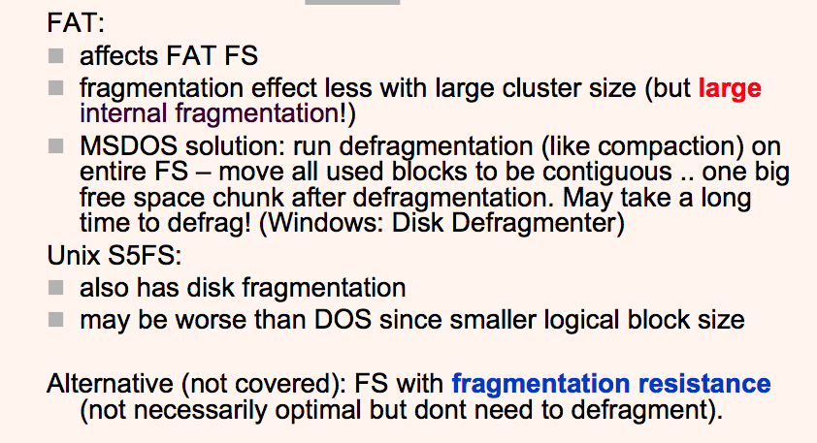
Disk Fragmentation

Slide 34
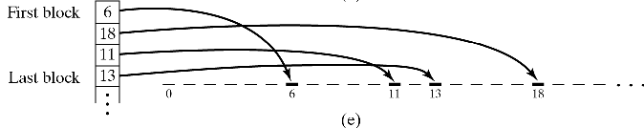
Physical Organization Methods
Indexed Organization
Index table: sequential list of records
Simplest implementation: keep index list in descriptor
Insert/delete is easy
Sequential and direct access is efficient
Drawback: file size limited by number of index entries

Slide 35
Physical Organization Methods
Variations of indexing
Multi-level index hierarchy
Primary index points to secondary indices
Problem: number of disk accesses increases with depth of hierarchy
Incremental indexing
Fixed number of entries at top-level index
When insufficient, allocate additional index levels
Example: Unix, 3-level expansion (see next slide)

Slide 36
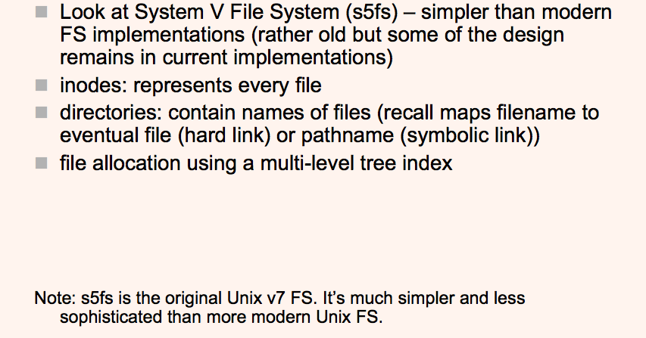
UNIX File Systems

Slide 37
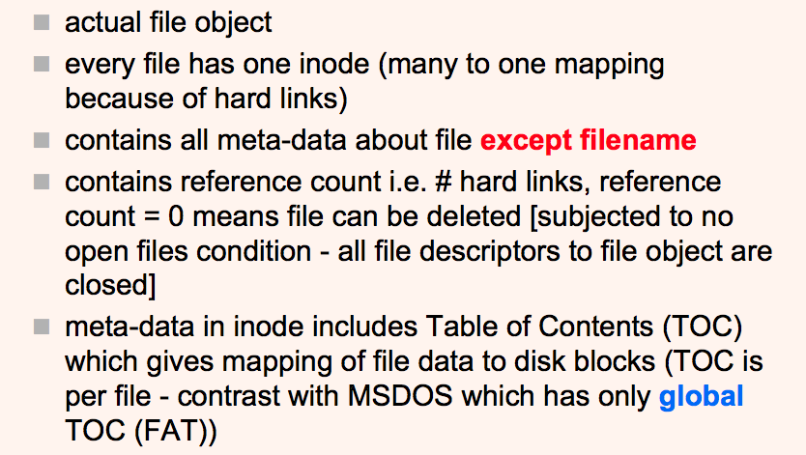
s5fs: Inodes

Slide 38
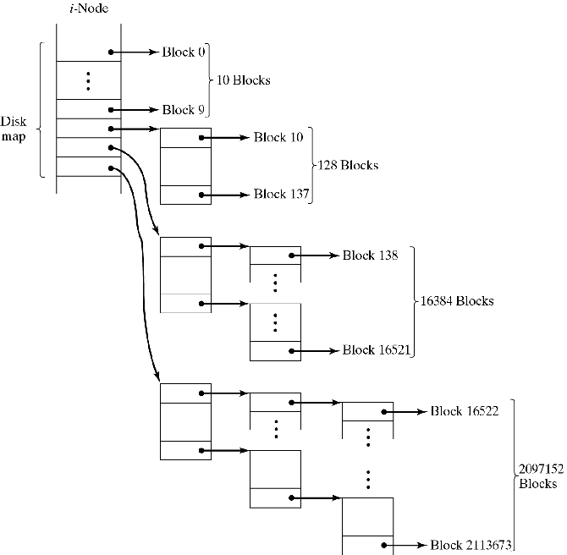
Unix Table of Contents (TOC)
Incremental indexing in Unix
file size vs. speed of access
blocks 0-9: 1 access (direct)
blocks 10-137: 2 accesses
blocks 138-16521: 3 acc.
etc.

Slide 39
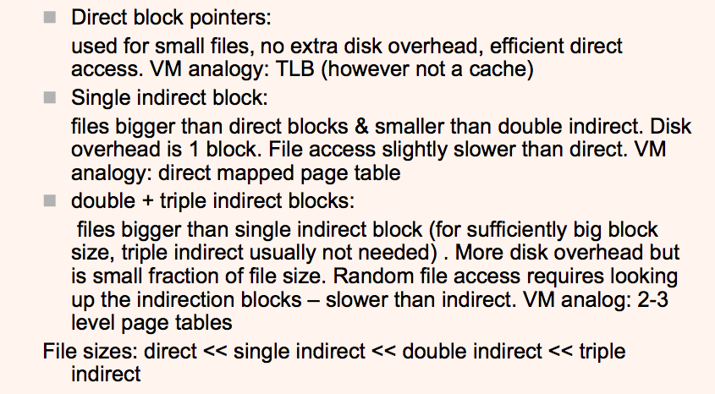
s5fs: TOC Index Blocks

Slide 40
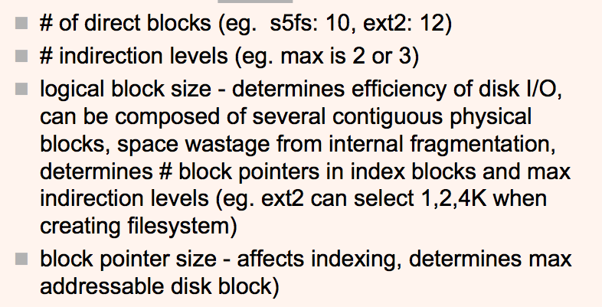
s5fs: File System Parameters

Slide 41
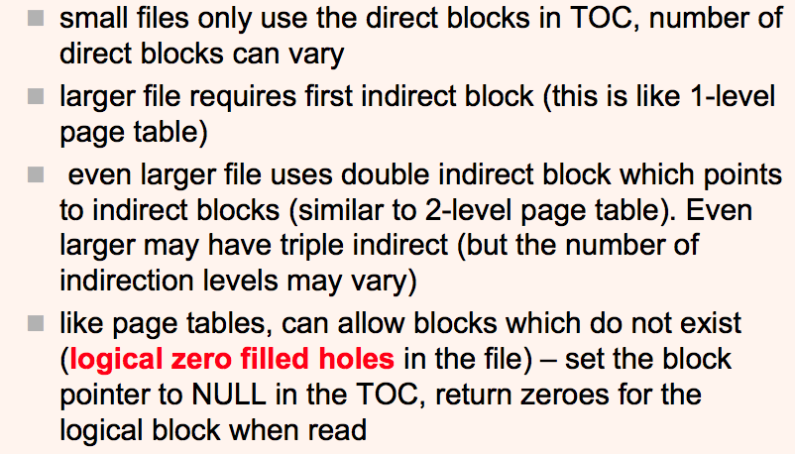
s5fs: File System Parameters

Slide 42
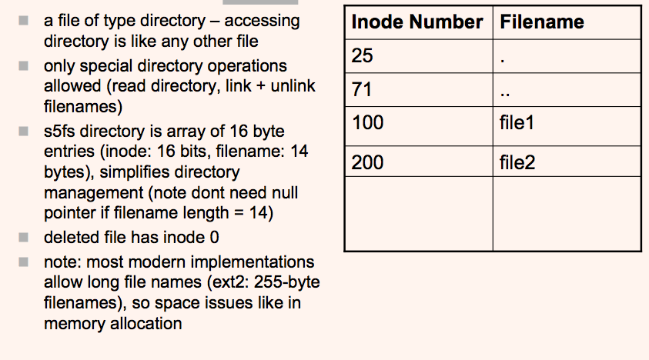
s5fs: Directories

Slide 43
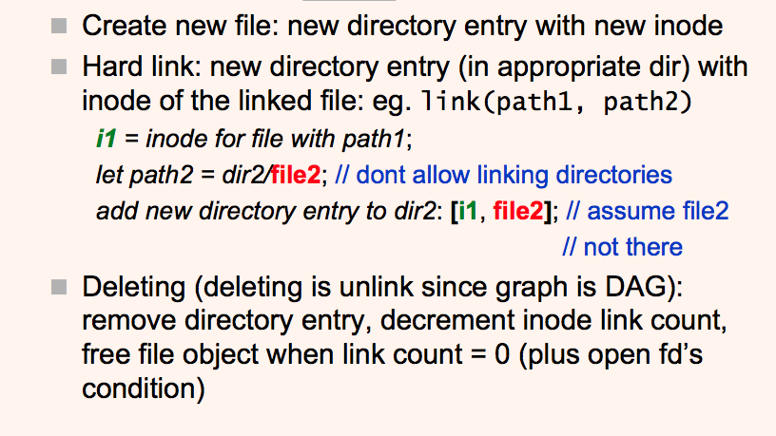
s5fs: Link + Unlink

Slide 44
Free Storage Space Management
Similar to main memory management
Linked list organization
Linking individual blocks -- inefficient:
no block clustering to minimize seek operations
groups of blocks are allocated/released one at a time
Better: Link groups of consecutive blocks
Bit map organization
Analogous to main memory
A single bit per block indicates if free or occupied

